Slide 1
Big Data in Education
Presented By,
Praneetha Thotakura
Srividya Ravipati

Slide 2
Big Data in Education
Big Data: Big Data is a collection of data that is huge in volume yet growing exponentially with time. It is a data with so large size and complexity that none of traditional data management tools can store it or process it efficiently.
Big data is an essential aspect of innovation which has gained major attention from both academics and practitioners.
This can help universities and colleges to transform their business models, student academic outcomes and professors effectiveness.
Also, big data provides academic institutions with opportunities to intergrade critical systems, applications and platforms. This may allow them to create efficiencies and reduce costs.
How Big Data is Transforming the Education? – It influences how schools attract and view prospective students and how professor server current students. In addition, discovering new technologies and innovations are creating new opportunities for the future use of big data in education. → Planning for the Future → Empowering Professors → Creating new opportunities

Slide 3
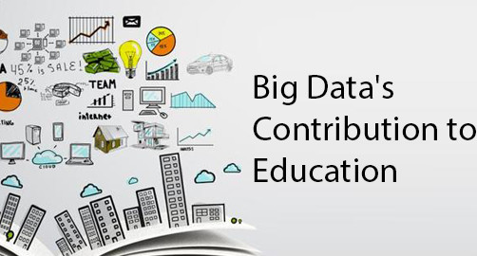
Applications
As thousands of students enroll in several institutes every year in a variety of courses, a humungous amount of data is generated. The student data consists of course details, enrollment year, student ID, exam grades and marks obtained in individual subjects.
→ Enhancing Student Results → Better Grading System → Gaining Attention → Customized Programs → Reducing the number of Dropouts

Slide 4

Real – Life Scenario
Here, there is a real time situation where Big Data helped to improve the education in Bangladesh.
Bangladesh has one of the largest primary education systems in the world according to Directorate of Primary Education. But they lack in human resources which will be a major impediment to the economic development of the country.
They thought that Big Data and AI can produce the good result in such a way that → Student can improve the results → Create Mass – customized Programs → Improve the learning experience in Real-time
Similarly, the Georgia State University also used stacks of information to create a National model on how to keep students on track to graduate.

Slide 5
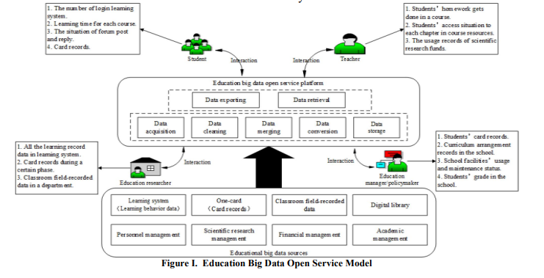
Big Data analytics can resolve all the issues of the education sector. Georgia State University for example adopted new data analytic tools to deliver solutions to the long pending problem of student retention.
Harvard, The University of California and others are using social media as an advertising tool. There are few prominent factors that drive students to educational institution namely personal factors, academic quality, facility, campus, socialization, financial aid and policies.
Research done at the University of New Hampshire shows 96% students use Facebook, 84% use YouTube, 20% use blogs and 14% use Twitter. Through sentiment analysis of the student’s sentiments helps wonders in the student enrolment process. Big Data solutions therefore serve as insight analysis podium

Slide 6
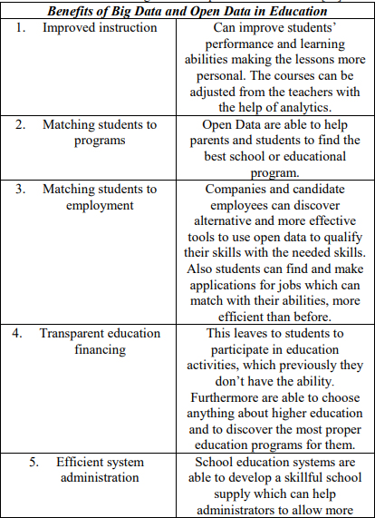

Goals and Purposes
Big Data has the future to change not just research, but also education. The collaboration technologies which the Big Data are based on them is Cloud Computing.
These technologies can improve educational services, giving young and adult students alike access to low-cost content, online instructors and communities of fellow learners.
Benefits of the big data in education is explained in the beside diagram.

Slide 7

Project Demonstration
Title : Students Performance In Exams

Slide 8
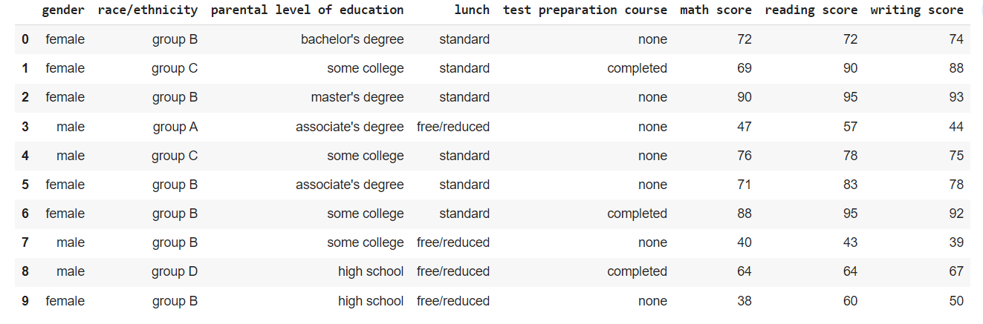
Proposed Method
In this project, I have tried to determine which features affect the student’s subject wise and overall performance by looking at the data distribution overall and also based on clusters formed on the basis of scores.
Here, we implemented the project by determining the performance analysis.
Dataset : We took the dataset which is named as StudentsPerformance.csv
This dataset consists of 1000 rows and 8 columns and data size is of 8000.
Also, I verified whether there are any null values in the dataset.
The columns of the dataset are described as
gender : sex of students
race/ethnicity : ethnicity of students
parental level of education : parents' final education
lunch : having lunch before test (normal or abnormal)
test preparation course : complete or not complete before test
Math score : math score is obtained
Reading score: reading score is obtained.
Writing score: writing score is obtained.

Slide 9
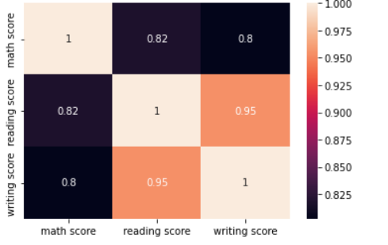
Initial observations
In our project, we obtained the performance of each field for male and female.
The results are obtained in the form of histograms
Similarly, we can see the male has better performance on math field, but identified worse on reading and writing
Also, I plotted correlation matrix between the attributes named as math score, reading score, writing score. I identified reading score and writing score are highly co-related with (0.95) coefficient.

Slide 10
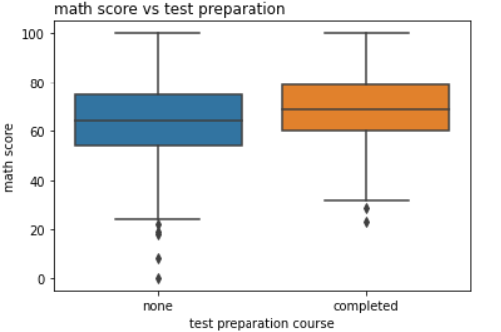
Box plot is also called whisker plot which is also implemented in our project where we draw a box from the first quartile to the third quartile.
The score distribution got narrower if students complete the preparation before the test, and also we can see that the average score is better.

Slide 11
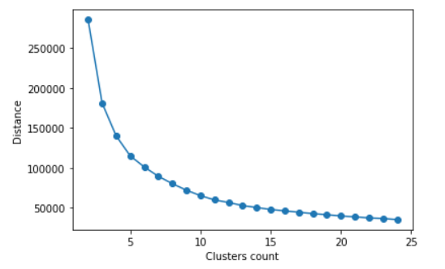
K-Means Clustering
Generally, a cluster refers to a collection of data points aggregated together because of certain similarities.
We’ll use the Scikit-learn library and some data which is related to the project. → from sklearn.cluster import Kmeans
In order to classify the students into groups and check which features affects the scores significantly we used this clustering concept.

Slide 12
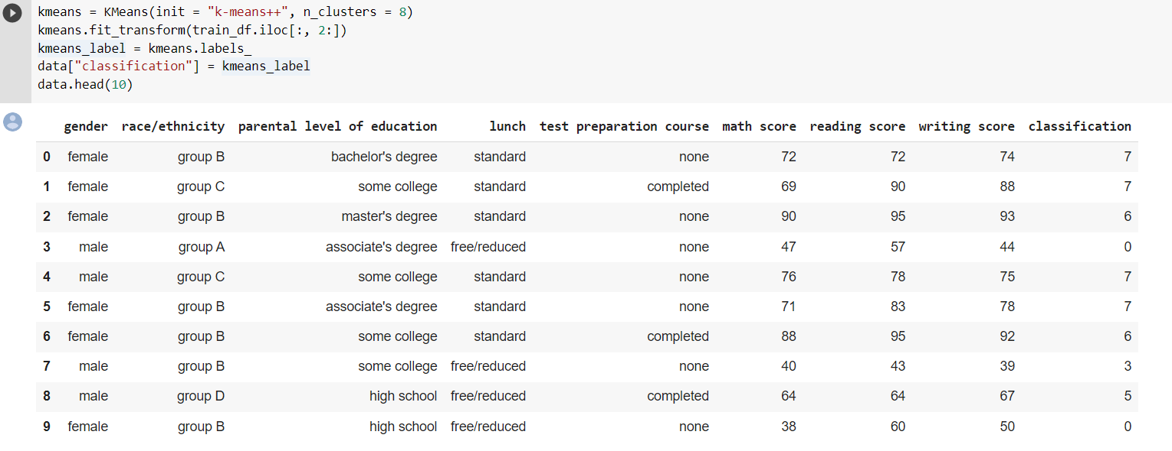
We have taken the 8 number of clusters and the data is classified by means K-Means clustering
This concept is a type of unsupervised machine learning which aims to find homogeneous subgroups such that objects in the same group (clusters) are more similar to each other than the others.

Slide 13
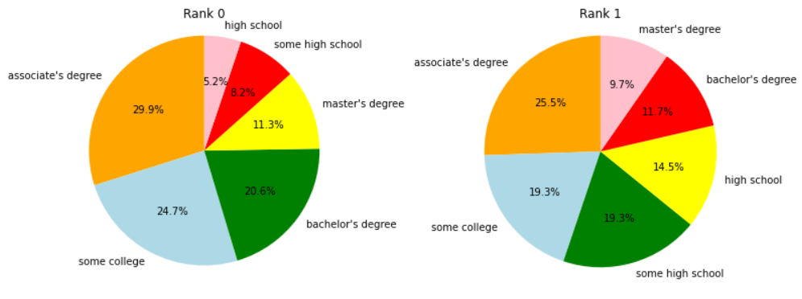
We can find out the correlation between the performance of students and features.
We plotted a pie chart to check whether education level of parents can affect the performance or not.

Slide 14
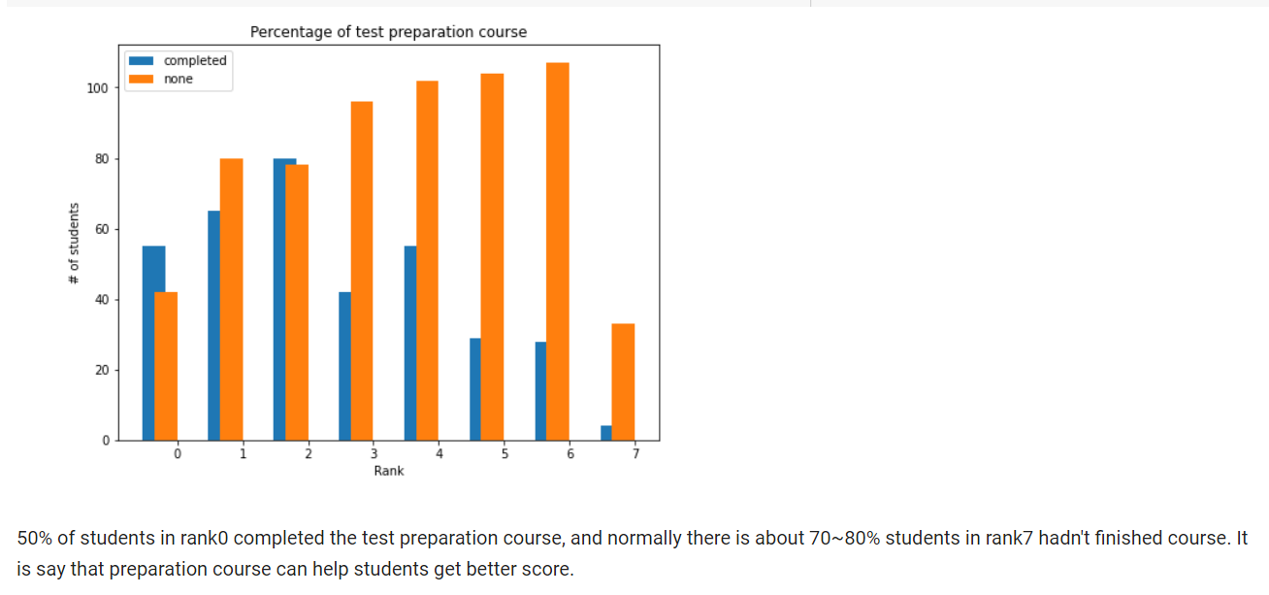
Outcomes
Parents education level may affect the performance of students. (Pie charts)
Writing and Reading are highly correlated. (From Heatmap)
Finishing preparation course is beneficial. (Boxplots and k means)

Slide 15
Conclusion
Big data can really improve the education. It can afford to shape a modern and dynamic education system, which every individual student can have the maximum benefit from that.
The teachers have valuable tools, were they don’t have before, which can make their decisions more specific and are able to choose a big variety of new learning methods.
In the new era of Data the traditional difficulties will be no longer exists, keeping the good methods. The education system will be enriched with new learning ways, making more efficient and targeted.
Furthermore, the teachers and academics must actually train and involved on them and finally the students must accept and use these new tools.

Slide 16
Thank You

